Slide 1
Analysis of Algorithms
NP Completeness

Slide 2
NP-Completeness
Polynomial-time algorithms
on inputs of size n, worst-case running time is O(n^{k}), for a constant k
Not all problems can be solved in polynomial time
Some problems cannot be solved by any computer no matter how much time is provided (Turing’s Halting problem) – such problems are called undecidable
Some problems can be solved but not in O(n^{k})

Slide 3
Turing’s Halting Problem
The halting problem
Given a program and inputs for it, decide whether it will run forever or will eventually stop.
This is not the same thing as actually running a given program and seeing what happens. The halting problem asks whether there is any general prescription for deciding how long to run an arbitrary program so that its halting or non-halting will be revealed.
In this abstract framework, there are no resource limitations of memory or time on the program's execution; it can take arbitrarily long, and use arbitrarily much storage space, before halting.
Example
while(1) {x = x+1;}
The reason the halting problem is famous is because it is undecidable, which means there is no computable function that correctly determines which programs halt and which ones do not.

Slide 4
Polynomial Time
Polynomial time solvable problem are regarded as tractable.
Even if the current best algorithm for a problem has a running time of Θ(n¹⁰⁰), it is likely that an algorithm with a much better running time will soon be discovered.
Problems for many reasonable models of computation, that can be solved in one model can be solved in polynomial in another.
Polynomial-time solvable problems has a nice closure property.

Slide 5
Class of “P” Problems
Class P consists of (decision) problems that are solvable in polynomial time:
there exists an algorithm that can solve the problem in O(n^{k}), k constant
Problems in P are also called tractable
Problems not in P are also called intractable
Can be solved in reasonable time only for small inputs

Slide 6
Decision problems
A class of problems where for each input algorithm
have to produce one of two possible answers - “yes” or
“no”, i.e. computable functions of the type
f: N → {0,1}

Slide 7
Optimization & Decision Problems
Decision problems
Given an input and a question regarding a problem, determine if the answer is yes or no
Optimization problems
Find a solution with the “best” value
Optimization problems can be cast as decision problems that are easier to study
E.g.: Shortest path: G = unweighted directed graph
Find a path between u and v that uses the fewest edges
Does a path exist from u to v consisting of at most k edges?

Slide 8
Nondeterministic Algorithms
Nondeterministic algorithm = two stage procedure:
Nondeterministic (“guessing”) stage:
generate an arbitrary string that can be thought of as a candidate solution (“certificate”)
Deterministic (“verification”) stage:
take the certificate and the instance to the problem and returns YES if the certificate represents a solution
Nondeterministic polynomial (NP) = verification stage is polynomial

Slide 9
Class of “NP” Problems
Class NP consists of problems that are verifiable in polynomial time (i.e., could be solved by nondeterministic polynomial algorithms)
If we were given a “certificate” of a solution, we could verify that the certificate is correct in time polynomial to the size of the input

Slide 10
E.g.: Hamiltonian Cycle
Given: a directed graph G = (V, E), determine a simple cycle that contains each vertex in V
Each vertex can only be visited once
Certificate:
Sequence: ⟨v₁, v₂, v₃, …, v_{|V|}⟩
Verification:
1) (v_{i}, v_{i+1}) ∈ E for i = 1, …, |V|
2) (v_{|V|}, v₁) ∈ E
hamiltonian
not
hamiltonian

Slide 11
Polynomial Reduction Algorithm
Polynomial time algorithm to decide A
yes
A
f
B
Polynomial time
algorithm to decide B
yes
no
no
To solve a decision problem A in polynomial time
Use a polynomial time reduction algorithm to transform A into B
Run a known polynomial time algorithm for B
Use the answer for B as the answer for A

Slide 12
Reductions
Given two problems A, B, we say that A is reducible to B (A ≤_{p} B) if:
There exists a function f that converts the input of A to inputs of B in polynomial time
A(i) = YES ⇔ B(f(i)) = YES

Slide 13
NP-Completeness
A problem B is NP-complete if:
1) B ∈ NP
2) A ≤_{p} B for all A ∈ NP
If B satisfies only property 2) we say that B is NP-hard
No polynomial time algorithm has been discovered for an NP-Complete problem
No one has ever proven that no polynomial time algorithm can exist for any NP-Complete problem

Slide 14
NP-Completeness (why NPC?)
A problem p ∈NP, and any other problem p′ can be translated as p in poly time.
So if p can be solved in poly time, then all problems in NP can be solved in poly time.

Slide 15
Proving NP-Completeness
Theorem: If A is NP-Complete and A ≤_{p} B
⇒ B is NP-Hard
In addition, if B ∈ NP
⇒ B is NP-Complete
Proof: Assume that B ∈ P
Since A ≤_{p} B ⇒ A ∈ P contradiction!
⇒ B is NP-Hard

Slide 16
Proving NP-Completeness
Prove that the problem B is in NP
A randomly generated string can be checked in polynomial time to determine if it represents a solution
Show that one known NP-Complete problem can be transformed to B in polynomial time
No need to check that all NP-Complete problems are reducible to B

Slide 17
Is P = NP?
Any problem in P is also in NP:
P ⊆ NP
We can solve problems in P, even without having a certificate
The big (and open question) is whether P = NP
Theorem: If any NP-Complete problem can be solved in polynomial time ⇒ then P = NP.
P
NP-complete
NP

Slide 18
Relation among P, NP, NPC
P ⊆ NP (Sure)
NPC ⊆ NP (sure)
P = NP (or P ⊂ NP, or P ≠ NP) ???
NPC = NP (or NPC ⊂ NP, or NPC ≠ NP) ???
P ≠ NP: one of the deepest, most perplexing open research problems in (theoretical) computer science since 1971.

Slide 19
Arguments about P, NP, NPC
No poly algorithm found for any NPC problem (even so many NPC problems)
No proof that a poly algorithm cannot exist for any of NPC problems, (even having tried so long so hard).
Most theoretical computer scientists believe that NPC is intractable (i.e., hard, and P ≠ NP).

Slide 20
View of Theoretical Computer Scientists on P, NP, NPC
NP
NPC
P
P ⊂ NP, NPC ⊂ NP, P ∩ NPC = ∅

Slide 21
Why discussion on NPC
If a problem is proved to be NPC, a good evidence for its intractability (hardness).
Not waste time on trying to find efficient algorithm for it
Instead, focus on design approximate algorithm or a solution for a special case of the problem
Some problems looks very easy on the surface, but in fact, is hard (NPC).

Slide 22
P & NP-Complete Problems
Shortest simple path
Given a graph G = (V, E) find a shortest path from a source to all other vertices
Polynomial solution: O(VE)
Longest simple path
Given a graph G = (V, E) find a longest path from a source to all other vertices
NP-complete

Slide 23
P & NP-Complete Problems
Euler tour
G = (V, E) a connected, directed graph find a cycle that traverses each edge of G exactly once (may visit a vertex multiple times)
Polynomial solution O(E)
Hamiltonian cycle
G = (V, E) a connected, directed graph find a cycle that visits each vertex of G exactly once
NP-complete

Slide 24
A First NP-complete problem
Because the technique of reduction relies on having a problem already known to be NP-complete in order to prove a different problem NP-complete,
we need a “first” NPC problem.
Circuit-satisfiability problem

Slide 25
First NP-complete problem—Circuit Satisfiability (problem definition)
Boolean combinational circuit
Boolean combinational elements, wired together
Each element, inputs and outputs (binary)
Limit the number of outputs to 1.
Called logic gates: NOT gate, AND gate, OR gate.
true table: giving the outputs for each setting of inputs
true assignment: a set of boolean inputs.
satisfying assignment: a true assignment causing the output to be 1
A circuit is satisfiable if it has a satisfying assignment.

Slide 26
Circuit Satisfiability Problem: definition
Circuit satisfying problem:
given a boolean combinational circuit composed of AND, OR, and NOT, is it stisfiable?
CIRCUIT-SAT={<C>: C is a satisfiable boolean circuit}
Implication:
in the area of computer-aided hardware optimization, if a subcircuit always produces 0, then the subcircuit can be replaced by a simpler subcircuit that omits all gates and just output a 0.

Slide 27
Circuit Satisfiability Problem

Slide 28
Solving circuit-satisfiability problem
Intuitive solution:
for each possible assignment, check whether it generates 1.
suppose the number of inputs is k, then the total possible assignments are 2^{k}. So the running time is Ω(2^{k}). When the size of the problem is Θ(k), then the running time is not poly.

Slide 29
Circuit Satisfiability: Theorem
Lemma 34.5.
The circuit-satisfiability problem belongs to the class NP.
Lemma 34.6.
The circuit-satisfiability problem is NP-hard.
Theorem 34.7.
The circuit-satisfiability problem is NP-Complete.

Slide 30
Circuit-satisfiability problem is NP-complete
Lemma 34.5: CIRCUIT-SAT belongs to NP.
Proof:
CIRCUIT-SAT is poly-time verifiable.
Given (an encoding of) a CIRCUIT-SAT problem C and a certificate, which is an assignment of boolean values to (all) wires in C.
The algorithm is constructed as follows: just checks each gates and then the output wire of C:
If for every gate, the computed output value matches the value of the output wire given in the certificate and the output of the whole circuit is 1, then the algorithm outputs 1, otherwise 0.
The algorithm is executed in poly time (even linear time).

Slide 31
Circuit-satisfiability problem is NP-complete (cont.)
Lemma 34.6: (page 991)
CIRCUIT-SAT is NP-hard.
Proof:
Difficult to proof
If you are interested, read from the book

Slide 32
NPC proof –Formula Satisfiability (SAT)
SAT definition
n boolean variables: x₁, x₂,…, x_{n}.
M boolean connectives: any boolean function with one or two inputs and one output, such as ∧,∨,¬,→,↔,… and
Parentheses.
A SAT φ is satisfiable
if there exists a true assignment which causes φ to evaluate to 1.
E.g.: Φ = (x₁ ∨ x₂) ∧ (x₁ ∨ ¬ x₂) ∧ (¬ x₁ ∨ ¬ x₂)
Certificate: x₁ = 1, x₂ = 0 ⇒ Φ = 1 ∧ 1 ∧ 1 = 1
SAT={< φ>: φ is a satifiable boolean formula}.
The historical honor of the first NP-complete problem ever shown.

Slide 33
SAT is NP-complete
Theorem 34.9: (page 997)
SAT is NP-complete.
Proof:
SAT belongs to NP.
Given a satisfying assignment, the verifying algorithm replaces each variable with its value and evaluates the formula, in poly time.
SAT is NP-hard (show CIRCUIT-SAT≤_{p} SAT).

Slide 34
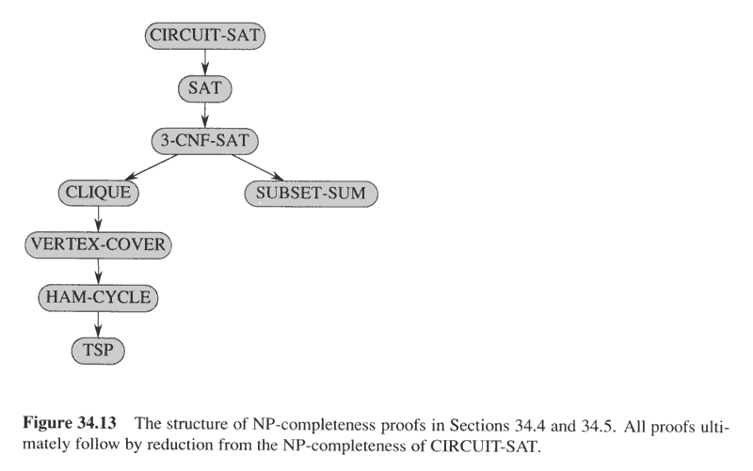
NP-completeness proof structure

Slide 35
3-CNF Satisfiability
3-CNF Satisfiability Problem:
n boolean variables: x₁, x₂, …, x_{n}
Literal: x_{i} or ¬ x_{i} (a variable or its negation)
Clause: c_{j} = an OR of three literals (m clauses)
Formula: Φ = c₁ ∧ c₂ ∧ … ∧ c_{m}
E.g.:
Φ = (x₁ ∨ ¬x₁ ∨ ¬x₂) ∧
(x₃ ∨ x₂ ∨ x₄) ∧
(¬x₁ ∨ ¬x₃ ∨ ¬ x₄)
3-CNF is NP-Complete

Slide 36
Clique
Clique Problem:
Undirected graph G = (V, E)
Clique: a subset of vertices in V all connected to each other by edges in E (i.e., forming a complete graph)
Size of a clique: number of vertices it contains
Optimization problem:
Find a clique of maximum size
Decision problem:
Does G have a clique of size k?
Clique(G, 2) = YES
Clique(G, 3) = NO
Clique(G, 3) = YES
Clique(G, 4) = NO

Slide 37
Clique Verifier
Given: an undirected graph G = (V, E)
Problem: Does G have a clique of size k?
Certificate:
A set of k nodes
Verifier:
Verify that for all pairs of vertices in this set there exists an edge in E

Slide 38
CLIQUE is NP-complete
Theorem 34.11: (page 1003)
CLIQUE problem is NP-complete.
Proof:
CLIQUE ∈NP:
given G=(V,E) and a set V'⊆V as a certificate for G. The verifying algorithm checks for each pair of u,v∈V', whether <u,v> ∈E. time: O(|V'|²|E|).
CLIQUE is NP-hard:
show 3-CNF-SAT ≤_{p}CLIQUE.
The result is surprising, since from boolean formula to graph.

Slide 39
3-CNF ≤_{p} Clique
Start with an instance of 3-CNF:
Φ = C₁ ∧ C₂ ∧ … ∧ C_{k} (k clauses)
Each clause C_{r} has three literals: C_{r} = l₁^{r} ∨ l₂^{r} ∨ l₃^{r}
Idea:
Construct a graph G such that Φ is satisfiable only if G has a clique of size k

Slide 40
3-CNF ≤_{p} Clique
Φ = C₁ ∧ C₂ ∧ C₃
C₁ = x₁ ∨ ¬x₂ ∨ ¬x₃
x₁
¬x₂
¬x₃
C₂ = ¬x₁ ∨ x₂ ∨ x₃
C₃ = x₁ ∨ x₂ ∨ x₃
¬x₁
x₁
x₂
x₂
x₃
x₃
For each clause C_{r} = l₁^{r} ∨ l₂^{r} ∨ l₃^{r} place a triple of vertices v₁^{r}, v₂^{r}, v₃^{r} in V
Put an edge between two vertices v_{i}^{r} and v_{j}^{s} if:
v_{i}^{r} and v_{j}^{s} are in different triples
l_{i}^{r} is not the negation of l_{j}^{s} (consistent correspondent literals)

Slide 41
3-CNF ≤_{p} Clique
Φ = C₁ ∧ C₂ ∧ C₃
Suppose Φ has a satisfying assignment
Each clause C_{r} has a literal assigned to 1 – this corresponds to a vertex v_{i}^{r}
Picking one such literal from each C_{r} ⇒ a set V’ of k vertices
C₁ = x₁ ∨ ¬x₂ ∨ ¬x₃
x₁
¬x₂
¬x₃
¬x₁
x₁
x₂
x₂
x₃
x₃
C₂ = ¬x₁ ∨ x₂ ∨ x₃
C₃ = x₁ ∨ x₂ ∨ x₃
Claim: V’ is a clique
∀ v_{i}^{r}, v_{j}^{s} ∈ V’ the corresponding literals are 1 ⇒ cannot be complements
by the design of G the edge (v_{i}^{r}, v_{j}^{s}) ∈ E

Slide 42
3-CNF ≤_{p} Clique
Φ = C₁ ∧ C₂ ∧ C₃
C₁ = x₁ ∨ ¬x₂ ∨ ¬x₃
Suppose G has a clique
of size k
No edges between nodes
in the same clause
Clique contains only one
vertex from each clause
Assign 1 to vertices in
the clique
The literals of these vertices cannot belong to complementary literals
Each clause is satisfied ⇒ Φ is satisfied
x₁
¬x₂
¬x₃
¬x₁
x₁
x₂
x₂
x₃
x₃
C₂ = ¬x₁ ∨ x₂ ∨ x₃
C₃ = x₁ ∨ x₂ ∨ x₃

Slide 43
NP-completeness proof structure

Slide 44
Vertex Cover
G = (V, E), undirected graph
Vertex cover = a subset V’ ⊆ V
such that covers all the edges
if (u, v) ∈ E then u ∈ V’ or v ∈ V’ or both.
Size of a vertex cover = number of vertices in it
Problem:
Find a vertex cover of minimum size
Does graph G have a vertex cover of size k?
u
v
z
z
w
w
y
x

Slide 45
The Traveling Salesman Problem
G = (V, E), |V| = n, vertices represent cities
Cost: c(i, j) = cost of travel from city i to city j
Problem: salesman should make a tour (hamiltonian cycle):
Visit each city only once
Finish at the city he started from
Total cost is minimum
TSP = tour with cost at most k
u
v
1
3
2
1
x
w
5
⟨u, w, v, x, u⟩

Slide 46
Traveling-salesman problem is NPC
TSP={<G,c,k>:
G=(V,E) is a complete graph,
c is a function from V×V→Z,
k∈Z, and G has a traveling salesman
tour with cost at most k.}
Theorem 34.14: (page 1012)
TSP is NP-complete.

Slide 47
TSP ∈ NP
Certificate:
Sequence of n vertices, cost
E.g.: ⟨u, w, v, x, u⟩, 7
Verification:
Each vertex occurs only once
Sum of costs is at most k
u
v
1
3
2
1
x
w
5

Slide 48
HAM-CYCLE ≤_{p} TSP
Start with an instance of Hamiltonian cycle G = (V, E)
Form the complete graph G’ = (V, E’)
E’ = {(i, j): i, j ∈ V and i ≠ j}
0 if (i, j) ∈ E
1 if (i, j) ∉ E
TSP: ⟨G’, c, 0⟩
G has a hamiltonian cycle ⇔ G’ has a tour of cost at most 0
u
v
1
3
2
1
c(i, j) =
x
w
5
u
1
v
0
0
0
0
x
w
0

Slide 49
HAM-CYCLE ≤_{p} TSP
u
v
u
1
v
1
0
3
2
0
0
1
0
x
w
x
w
5
0
G has a hamiltonian cycle h
Each edge in h ∈ E ⇒ has cost 0 in G’
h is a tour in G’ with cost 0
G’ has a tour h’ of cost at most 0
Each edge on tour must have cost 0
h’ contains only edges in E

Slide 50
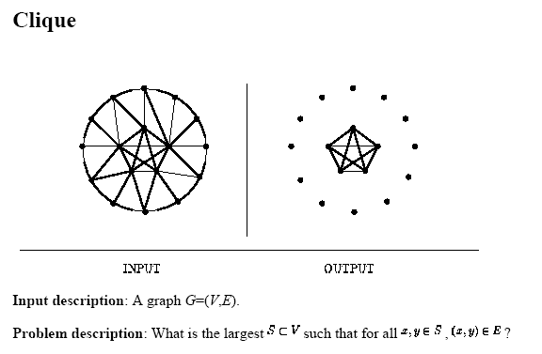
Some popular NP-complete problems

Slide 51
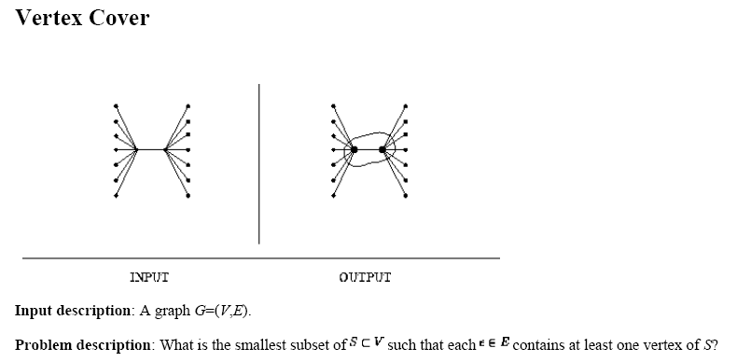
Some popular NP-complete problems

Slide 52
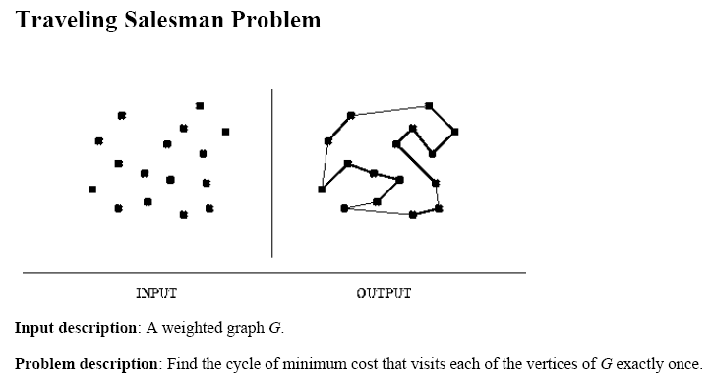
Some popular NP-complete problems

Slide 53
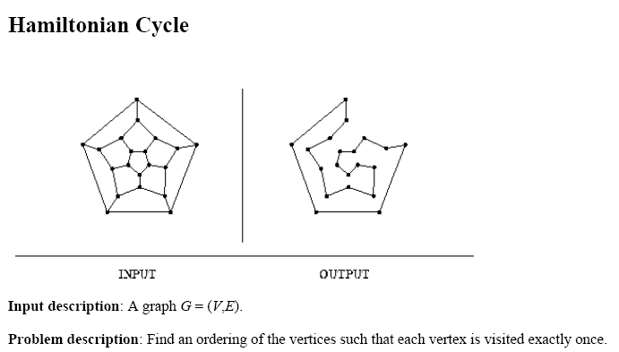
Some popular NP-complete problems

Slide 54
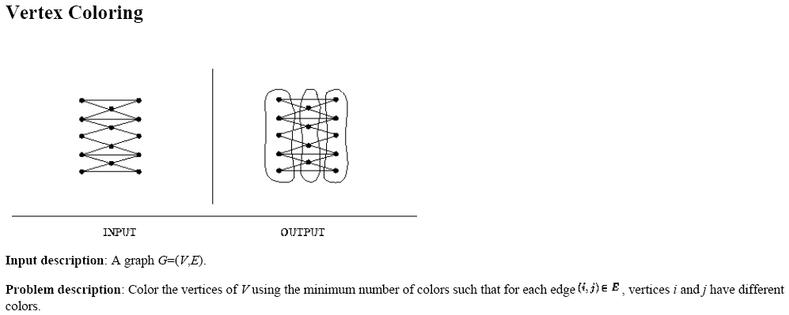
Some popular NP-complete problems

Slide 55
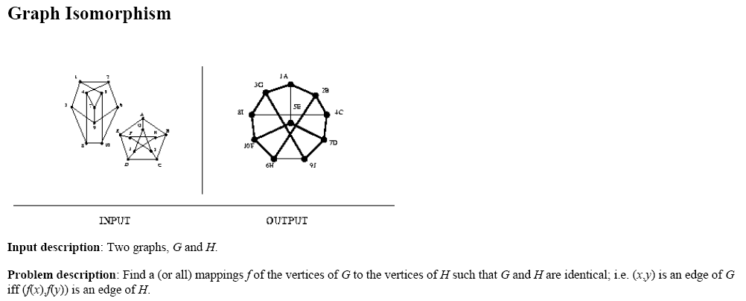
Some popular NP-complete problems

Slide 56
Readings & Watching
Chapter 34
https://www.youtube.com/watch?v=e2cF8a5aAhE

Slide 57
Thanks ALL

